Slide 1


Sensitivity of charge transport measurements to local inhomogeneities
Daniel W. Koon^{(a)}, Fei Wang^{(b)}, Dirch Hjorth Petersen^{(b)} , Ole Hansen^{(b+c)}
(a) Physics Dept., St. Lawrence University, dkoon@stlawu.edu,
(b) Department of Micro- and Nanotechnology, Technical University of Denmark, DTU Nanotech,
(c) Danish National Research Foundation’s Center for Individual Nanoparticle Functionality (CINF), DTU
Rigorous solution to the general problem of calculating sensitivities to local variations
  Extended to include local variations in N_{s}, μ, B as well as R_{S} and R_{HS}.
  Confirmed by simulation for both 4PP and vdP
Nonlinear [large] perturbations calculated for a variety of quantities, in zero and finite fields
  Confirms experimental evidence on physical holes
These equations allow for calculation of sensitivities for arbitrary specimen geometry modeled on N×N grid as an N³ process, rather than N⁵
  N² process for special cases.

Slide 2
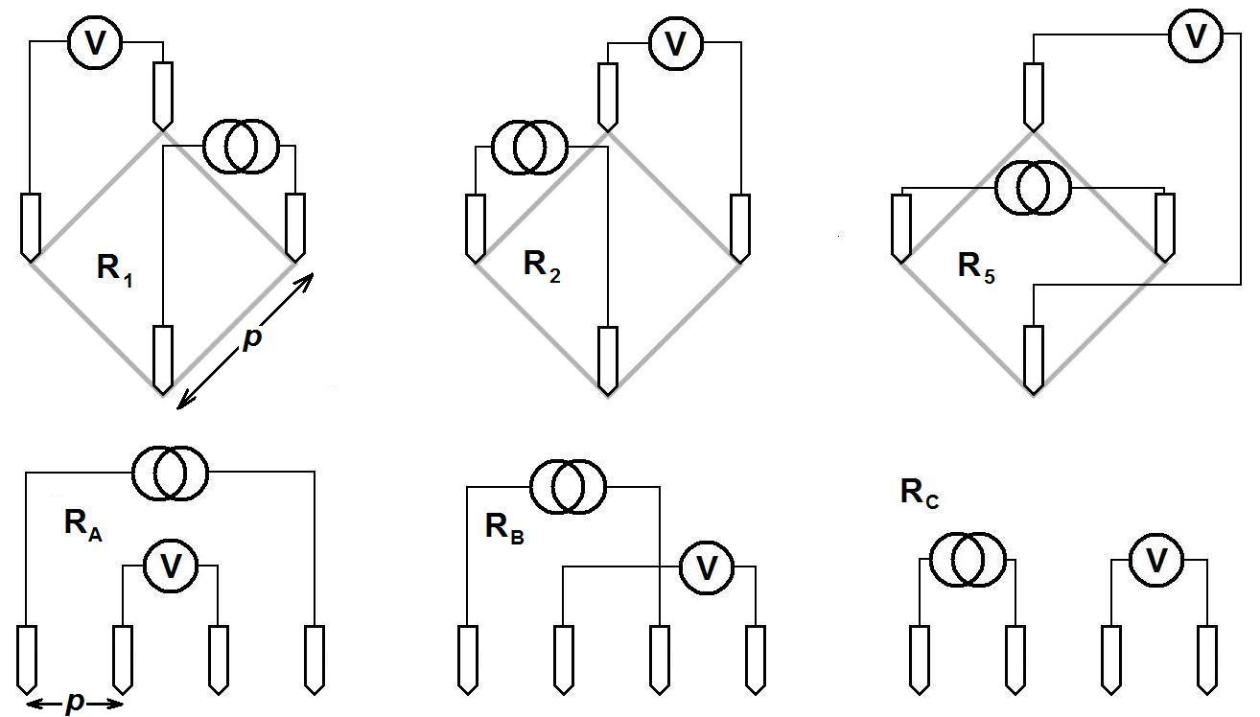
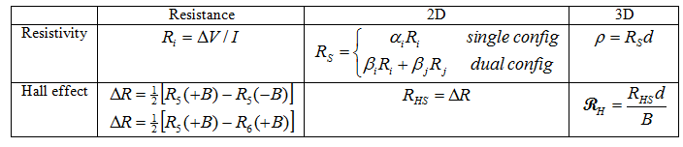
4-wire resistivity and Hall measurement
One measures charge transport quantities (resistivity, ρ, and Hall coefficient, R_{H}) by measuring 4-wire resistances
One converts resistances into 2D charge transport quantities (sheet resistance, R_{S}, and Hall sheet resistance, R_{HS}) by multiplying resistances by dimensionless geometrical factors, α_{i} (single-configuration techniques) or by averaging two independent configurations (dual configuration).
Geometrical factors well-known unless material is of nonuniform composition. How sensitive is measurement to inhomogeneities?

Slide 3
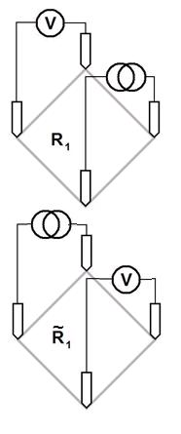
van der Pauw & four-point probe
van der Pauw [vdP]: (SLU)
Specimen of finite area, electrodes located at periphery.
Define Resistive, Hall weighting functions as weights by which local values are averaged by measurement.
Advantage: 2 simple functions.
four-point probe [4PP]: (DTU)
Specimen may be finite or approach limit of infinite size, with electrodes placed within borders.
Define sensitivity of resistive measurement to local sheet resistance, local mobility, carrier concentration, etc.
Advantage: more rigorous formalism, more flexible notation.

Slide 4
Weighting functions [vdP], sensitivities [4PP]
Define normalization area for each:
vdP: A′=Ω = finite area 4PP: A=p² = square of pitch
of specimen between probes
Sheet resistance:
So, S and f are the same,
Hall sheet resistance: aside from the definition of A.

Slide 5
Analytic form for Resistive and Hall
Weighting functions or Sensitivities: linear limit
Tildes refer to conjugate configuration, i.e. swapping current and voltage leads.

Slide 6
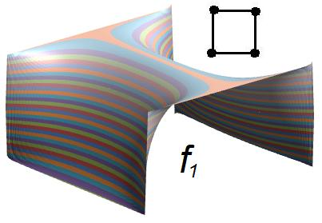
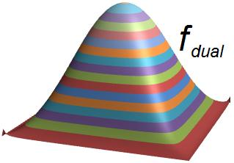
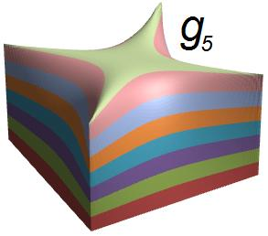
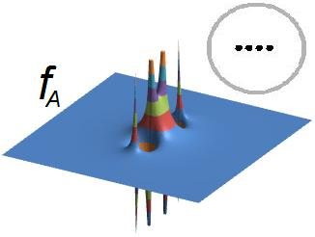
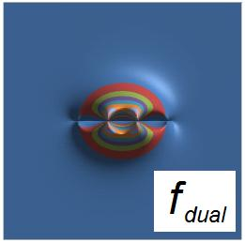
Weighting functions: square vdP & linear 4PP
Resistivity
Hall
......
Regions of negative weighting occur in single-configuration measurements for sheet resistance, though not for Hall measurement.
These can be eliminated by performing dual-configuration measurement.

Slide 7
Add nonlinearity of perturbation (zero mag. field)
Effect of large inhomogeneity is to use the perturbed local electric field, , instead of the unperturbed value in
This problem can be solved analytically.
For the resistive weighting function,
So, for the extreme case of physical holes in the specimen, nonlinearity is 2× linear effect.

Slide 8
Nonzero magnetic induction
For the general case of a finite specimen with four electrodes not at its edges, there is no simple expression for the B-dependence of f and g. In two specific cases, however, there is a simple form for the B-dependence: an infinite sheet and a sheet with electrodes at its boundaries (the van der Pauw geometry):

Slide 9
Finite magnetic field, perturbation:

Slide 10
Varying N_{s}, μ, B: one at a time

Slide 11
One difference for 4PP vs. vdP
Given that the weighting functions f and g vary with the magnetic field in the small-field limit,
Let’s test this with simulations...

Slide 12
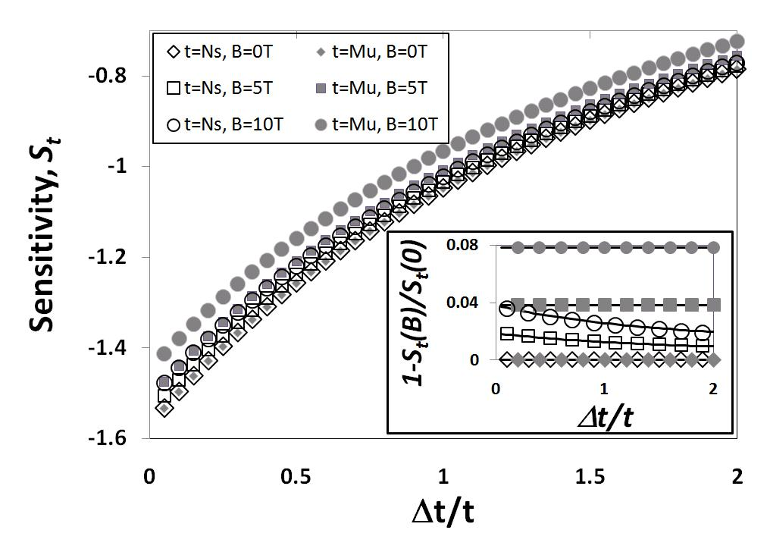
COMSOL simulation vs theory, 4PP linear array
Perturbation located
0.14p from second
electrode in a linear
4PP.
Agreement between fit
and all data to within
0.001 on main plot.
 | Best Fit | Theory
Resistive, f_{i,0} | 1.5717 | 1.5712
Hall, g_{i,0} | 1.447 | 1.472

Slide 13
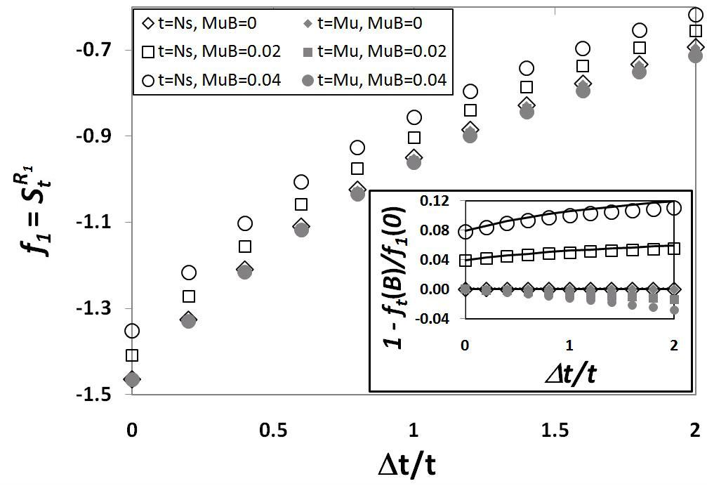
Excel simulation vs theory: vdP square
Probe equidistant from
adjacent current and
voltage probes, 0.3a
from edge of square of
side a.
Decent agreement with
theory, but disastrous fit
to 4PP predictions.
Hall angle, μB. same as
for Comsol simulation
(last slide).
 | Best Fit | Theory
Resistive, f_{i,0} | 1.465 | 1.45
Hall, g_{i,0} | -2.8428 | -2.81

Slide 14
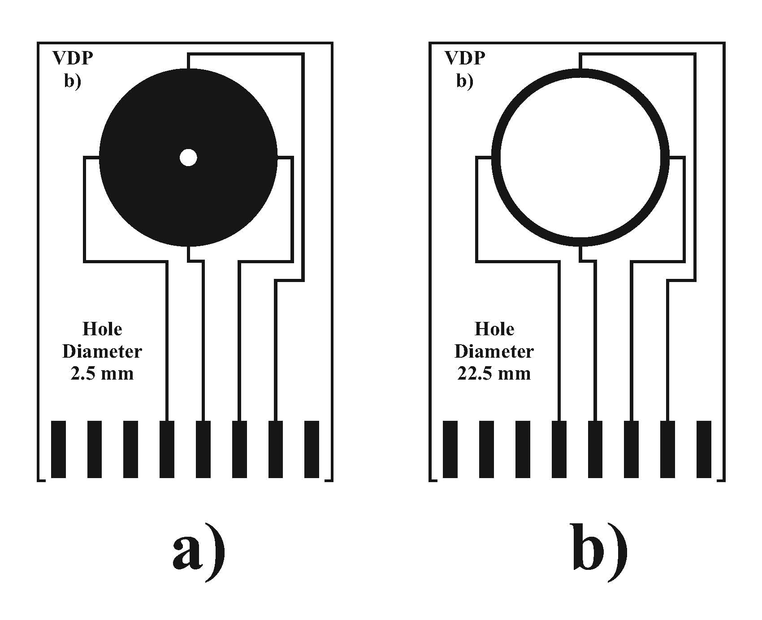
APPLICATION #1: Physical holes
The most extreme nonlinearity is removing conducting material from some part of the specimen: a physical hole.
So, 100% decrease in local R_{s} ductance has 200% the impact of a 1% decrease.
Figure: 25mm diameter, 35μm thick, 590±10μΩ copper foil vdP specimens with physical holes, from Josef Náhlík, Irena Kašpárková and Přemysl Fitl, Measurement, Volume 44, Issue 10, December 2011, Pages 1968–1979.

Slide 15
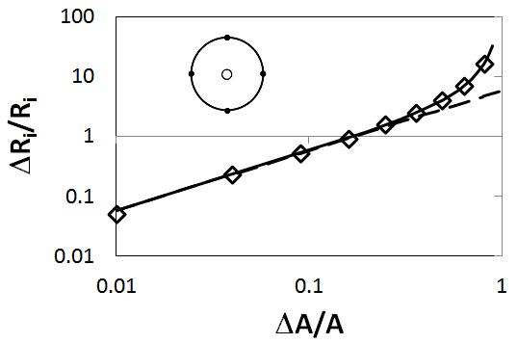
APPLICATION #1: Physical holes, continued
Single & dual vdP results.
Least squares fit to left-
most three data points is
shown in the plot. There
should be zero degrees of
freedom in the fit.
Surprisingly good fit up to about ΔA/A = 0.25, a hole half the diameter of the entire specimen, where disagreement between above fit & exact solution (solid line) is about 9%.
Experimental data: Josef Náhlík, Irena Kašpárková and Přemysl Fitl, Measurement, Volume 44, Issue 10, December 2011, Pages 1968–1979.
 | Fit | Expected
R_{S} | 584μΩ | 590±10μΩ (measured)
f_{i,0} | 2.886 | 2 / ln 2 ≈ 2.885 (theory)

Slide 16
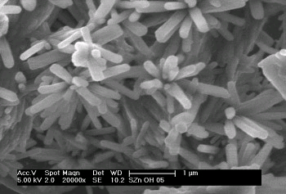
APPLICATION #2:
ZnO charge carrier polarity
ZnO samples have highly inhomogeneous R_{S}.
Internal holes in the specimen or radial inhomogeneities, if electrodes not located at the edges.
Can this produce R_{H} of the wrong sign, thus fool the measurer into imputing charge carriers of the wrong polarity?
Image: Scanning electron microscopic image of interfacially grown ZnO film. http://www.chemistry.manchester.ac.uk/groups/pob/research.html. Accessed 2/15/2012.
Citations: Takeshi Ohgaki, N. Ohashi, S. Sugimura, H. Ryoken, I. Sakaguchi, Y. Adachi, and H. Haneda, “Positive Hall coefficients obtained from contact misplacement on evident n-type ZnO films and crystals”, J. Mater. Res., 23 (9), 2293-2295 (2008).
Oliver Bierwagen, T. Ive, C. G. Van de Walle, J. S. Speck, “Causes of incorrect carrier-type identification in van der Pauw-Hall measurements”, App. Phys. Lett. 93, 242108 (2008).

Slide 17
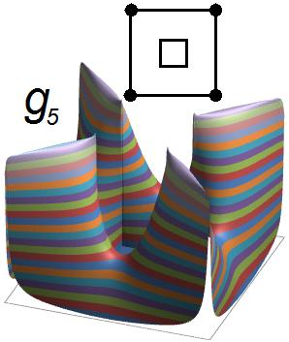
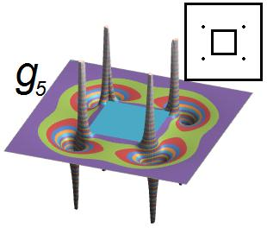
ZnO: Hall effect near interior hole: electrodes at edge, away from edge
Left: Electrodes at edges
→ No regions of negative weighting
→ Measured Hall signal lies within range of values within specimen.
Right: Interior electrodes
→ Regions of negative weighting
→ All bets are off, wrong polarity for Hall signal possible.
Takeshi Ohgaki, N. Ohashi, S. Sugimura, H. Ryoken, I. Sakaguchi, Y. Adachi, and H. Haneda, “Positive Hall coefficients obtained from contact misplacement on evident n-type ZnO films and crystals”, J. Mater. Res., 23 (9), 2293-2295 (2008).

Slide 18
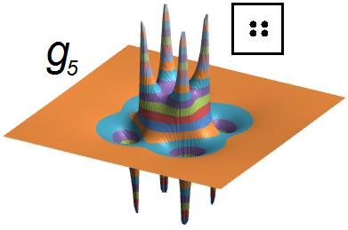
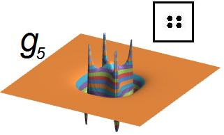
ZnO: Hall effect errors for electrodes away from edges
Electrodes in a square array 1/5 the size of the specimen.
Left: Homogeneous specimen. Integral of g₅ in negative weighting regions is 70% the magnitude of integral in positive weighting regions.
Right: Radial inhomogeneities (Carrier density increase 100x from center to corners in this example.) change the negative contribution to 99% of the positive. Odds of measuring a Hall signal lying outside values within the specimen rise.
Specimens described in: Oliver Bierwagen, T. Ive, C. G. Van de Walle, J. S. Speck, “Causes of incorrect carrier-type identification in van der Pauw-Hall measurements”, App. Phys. Lett. 93, 242108 (2008).

Slide 19
Conclusions
Rigorous solution to the general problem of calculating sensitivities to local variations
  Extended to include local variations in N_{s}, μ, & B as well as R_{S} & R_{HS}.
  Confirmed by simulation for both 4PP and vdP
Nonlinear [large] perturbations calculated for a variety of quantities, in zero and finite fields
  Confirms experimental evidence on physical holes
These equations allow for calculation of sensitivities for arbitrary specimen geometry modeled on N×N grid as an N³ process, rather than N⁵
  N² process for special cases.
Contact information: dkoon@stlawu.edu

